Slide 1
Junior Cycle Curriculum Reform
Parent’s Information Night

Slide 2
LEARNING INTENTIONS
Why do we need curriculum change?
Vision & Purpose of the Junior Cycle
What are the changes….
Assessment
What can you do?

Slide 3
An important question…
What type of education would you like for your daughter?

Slide 4
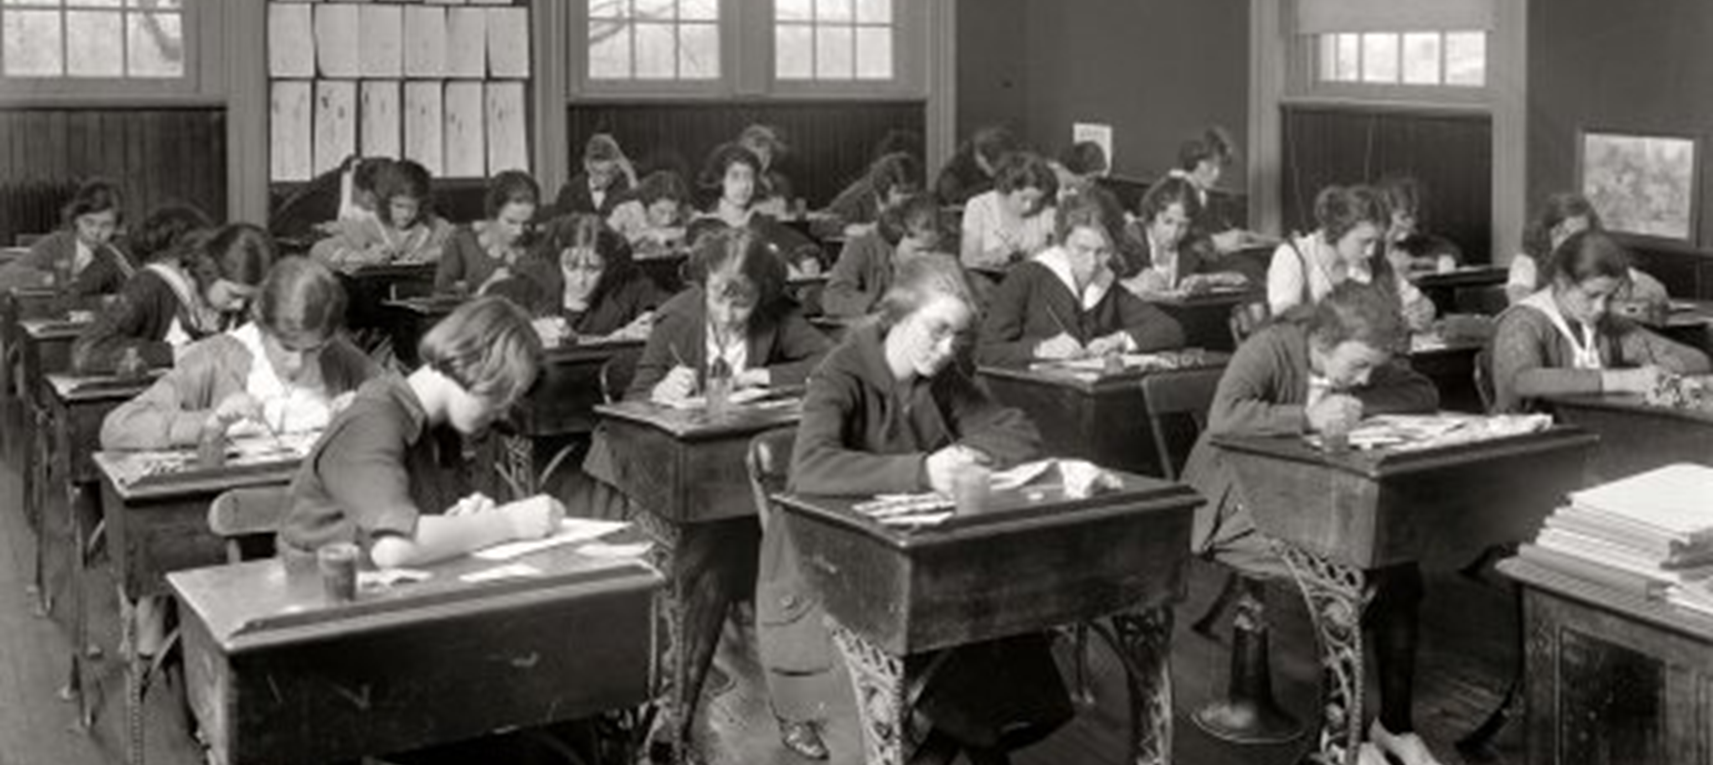
Irish classroom
1920’s & 2017…..

Slide 5
ESRI research
Many students are turned off learning in junior cycle
The Junior Certificate exam is dominating teaching and learning in many Irish classrooms
The curriculum is overcrowded
There is too much emphasis on covering content and not enough time for deeper learning or developing skills and understanding.
There is a narrow range of assessment activity - lots of tests!

Slide 6
Are they ready for life?
What skills have they learned?
What do they know and understand after the Leaving Certificate?
Can they stand up and give an oral presentation?
Can they work as part of a team?
Can they give their own opinion and critical explanation?
Computer skills?
Keep to dead lines?
Are they well?

Slide 7
Vision
“Junior cycle places students at the centre of the educational experience, enabling them to actively participate in their communities and in society and to be resourceful and confident learners in all aspects and stages of their lives”. (NCCA 2012)

Slide 8
What is the purpose of the Junior Cycle?
To help students make the successful transition from primary to post primary school
To help all students become better learners
To develop skills for learning and for life
To provide with a solid foundation for senior cycle
To give students a trial run for the Leaving Cert.
To encourage young people to develop a love of learning
To offer students new areas of learning such as wellbeing.

Slide 9
What type of educational experience is the Junior Cycle suggesting for your daughter?

Slide 10
The New Junior Cycle
Structure of the Junior Cycle
Assessment and Reporting
Level 2 Learning Programmes
Subjects
Wellbeing
Short Courses
Other Learning
Experiences
C
U
R
R
I
C
U
L
U
M
8 Key Skills
24 Statements of Learning
8 Principles
Notes:
.

Slide 11
Learning to Learn
Wellbeing
Choice and Flexibility
Inclusive Education
The Principles of Junior Cycle Education
Quality
Continuity and Development
Creativity and Innovation
Engagement and Participation

Slide 12
Statements of Learning:
'Schools will ensure that all statements of learning... feature in the programmes offered to all junior cycle students' Framework for Junior Cycle (2015) pg.12
Statements of Learning
Subjects
Short Courses
Other Learning Experiences

Slide 13
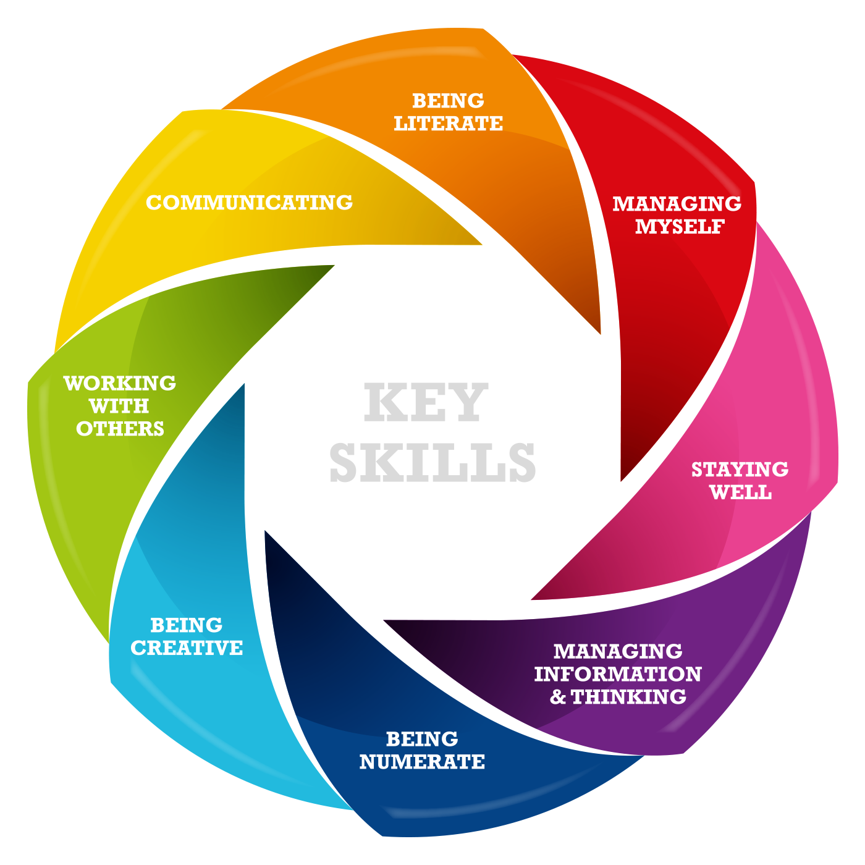

Slide 14
Level 2 Learning Programmes
Psychological Assessment
Individual Education Plan (IEP)
Personalised Pupil Plan (PPP) Circular 0030/2014
2 Short Courses
5 priority Learning Units
Priority Learning Units
Living in a community
Preparing for work
Communicating and literacy
Numeracy
Personal care
24 Statements of learning
8 Key kills
Short Courses and or Subjects
Two L2 Short courses
May take L3 Subjects

Slide 15
Spirituality
Ethics
Other areas of learning
24 Statements
of Learning
Guidance and Counselling
Computers
Other Learning Experiences
Pastoral Care
Co-curricular Activities
Key Skills
Citizenship
Student Council
Extra-curricular Activities

Slide 16
Subjects in the Curriculum:
English
Irish
18 Other Subjects
Maths
All Students MUST:
Essential Learning:
Schools may choose to make some of these core learning.

Slide 17
New area of learning - Wellbeing
Human flourishing

Slide 18
Well being in the New Junior Cycle..
Flourishing rests on Five Pillars:
Positive emotion
Engagement
Relationships
Meaning
Accomplishment

Slide 19
There is overwhelming evidence that students learn more effectively, including their academic subjects, if they are happy in their work, believe in themselves, their teachers and feel school is supporting them.
Weare. K. from the NCCA Draft Wellbeing Guidelines 2016

Slide 20
Learning about and for wellbeing
About Wellbeing
For Wellbeing
Health
Learning
Citizenship
Safety
Mental health
Study
Adolescence
Respected
Dialogue
Relationships
Growth mindset
Environment
Engaged
Extra-curricular

Slide 21
ILL-BEING
Appropriate negativity has an important role to play in flourishing
Constructive confrontation of problems and unacceptable behaviour
Well-being and ill-being exist together as part of the human condition
Negative emotions such as anger, fear, disgust and so on help us to respond appropriately to our environment – their adaptive value is easy to explain and understand (B. Fredrickson, 2003)

Slide 22
Wellbeing on the timetable
Year | PE | SPHE | CSPE | Other
1st Year | 2 | 1 | 1 | 1
2nd Year | 2 | 1 | 1
3rd Year | 2 | 1 | 1
2017 – 300 hours (5 periods a week)
2020 – 400 hours (6 periods a week)

Slide 23
ASSESSMENT IN THE NEW JUNIOR CERTIFICATE

Slide 24
Changes in Junior Cycle Assessment
Subject Learning and Assessment Review (SLAR)
Classroom
Based
Assessments (CBAs)
Formative Assessment
Assessment Task (AT)
State-certified examinations
Junior Cycle Profile of Achievement

Slide 25
Ongoing assessment that supports student learning

Slide 26
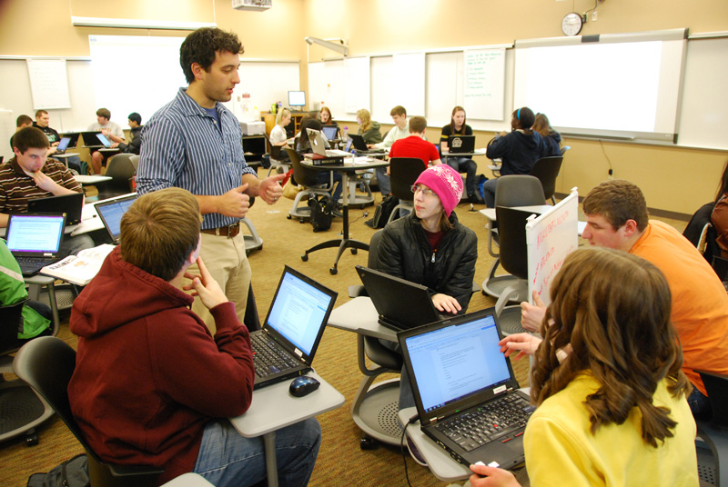
Classroom Based Assessments
provide students with opportunities to demonstrate their learning and understanding in a way that formal pen and paper examinations cannot
focus on the processes involved in the learning and not just the end product
Students will be given developmental feedback that will help them move their learning forward
Students may achieve success what ever that may look like for each student

Slide 27
Assessing the Classroom-Based Assessment
1.
2
Above expectations
In line with expectations
Not yet in line with expectations
4
3
Exceptional
For each Classroom-Based Assessment:
There are four standards for the Classroom Based assessment
These will be accompanied by features of quality that will be used to assess the pieces of student work.
These features of quality will be accompanied by exemplars of students’ work at the different levels.

Slide 28
Subject Learning and Assessment Review Meetings
Discussing how learning and teaching has been planned
Exploring how the context for learning provides the basis for the student work
Discuss examples of student work and reach agreement about the standard of that work, in general, and where relevant, on classroom based assessments (CBAs)

Slide 29
Assessment Task (AT)
Completed in 3rd year after second CBA
Highlights key learning experienced during the 2nd CBA
Completed in class over a period of time to a national timetable
Submitted to State Examination Commission in envelope with final script at end of third year
Resulted and marked by the SEC
Up to 10% of the final SEC grade

Slide 30
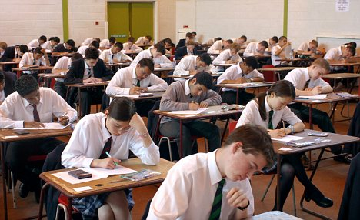
State Certified Examination
Set at common level with exception of English, Irish and Maths
Happens in June
2 hours duration in max. of 10 subjects
Set, administered, marked and resulted by the State Examinations Commission (SEC)
Recorded using a set of grades

Slide 31
STATE EXAMINATION GRADES
GRADE | RANGE (%)
Distinction | ≥90 to 100
Higher Merit | ≥75 and <90
Merit | ≥55 and >75
Achieved | ≥40 and <55
Partially Achieved | ≥20 and <40
(not graded) | ≥0 and <20

Slide 32
Junior Cycle Profile of Achievement
State Exam Results
Classroom Based Assessments
Short Courses
Priority Learning Units
Other Areas of Learning
School
Wellbeing
(2020)
Junior Cycle Profile of Achievement

Slide 33
Changes in Junior Cycle Assessment
Subject Learning and Assessment Review (SLAR)
Classroom
Based
Assessments (CBAs)
Formative Assessment
Assessment Task (AT)
State-certified examinations
Junior Cycle Profile of Achievement

Slide 34
An important question….
Does the Junior Cycle offer the education that you wish for your daughter?

